Slide 1



SKKU Biostats and Big data
CHOONG-WAN WOO | COCOAN lab | http://cocoanlab.github.io

Slide 2
GBME Probability and Statistics
Lecture 03
Lecture 03
Data visualization
CHOONG-WAN WOO | COCOAN lab | http://cocoanlab.github.io

Slide 3
Lecture 03
Quiz!
https://forms.gle/rUbz1gbXAowQLsfy8
CHOONG-WAN WOO | COCOAN lab | http://cocoanlab.github.io

Slide 4
Lecture 02
A statistician’s manifesto
(From T. Hastie, via J. McAuliffe, via Jordan Boyd-Graber)
Understand the ideas behind the statistical methods, so you know how to use them, when to use them, when not to use them.
Complicated methods build on simple methods. Understand simple methods first.
The results of a method are of little use without an assessment of how well or poorly it is doing.
CHOONG-WAN WOO | COCOAN lab | http://cocoanlab.github.io

Slide 5
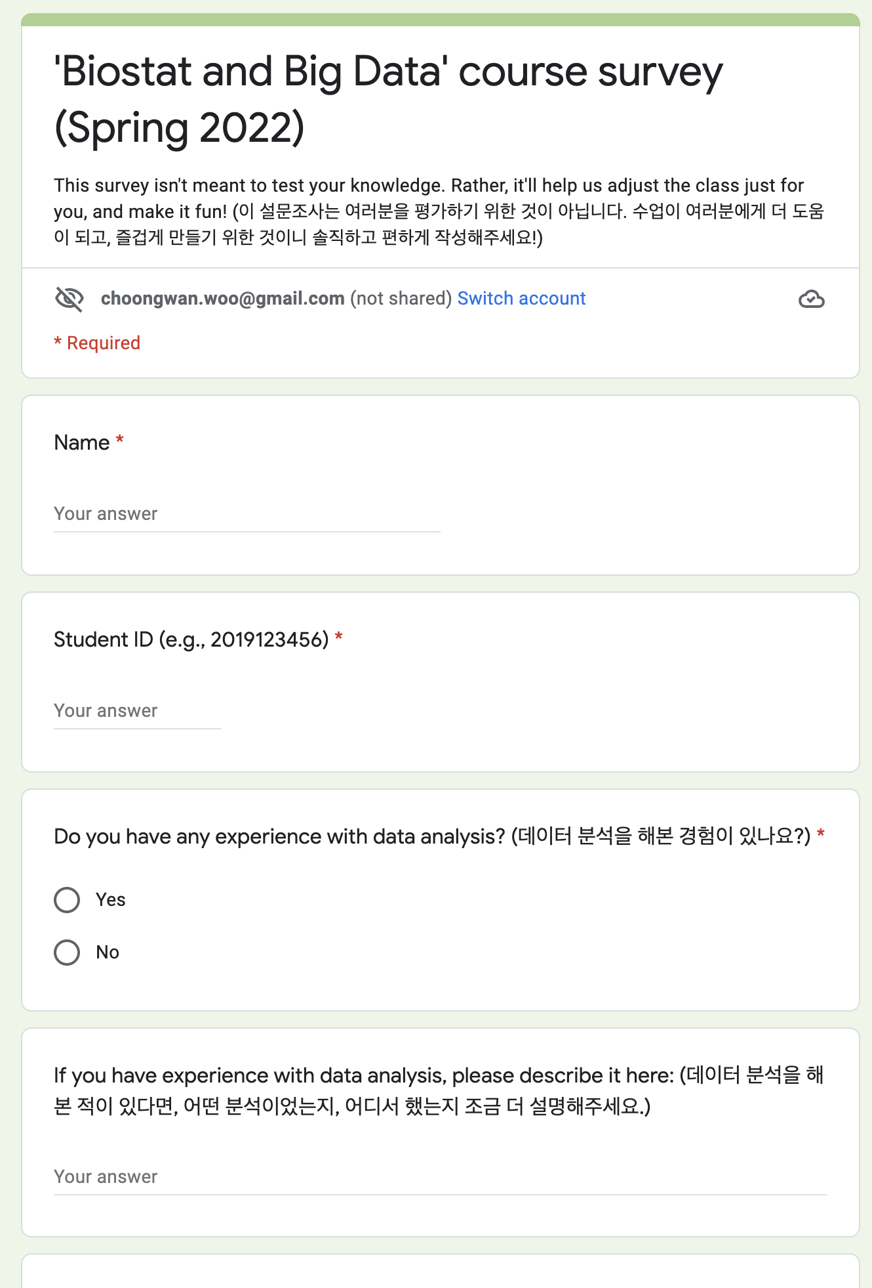
Lecture 03
Let’s go over the survey results
CHOONG-WAN WOO | COCOAN lab | http://cocoanlab.github.io

Slide 6

Lecture 03
Three Rules of Data Analysis
Make a picture
Make a picture
Make a picture
To think, show, and tell…
And to make it cool!
E.g., https://d3js.org
CHOONG-WAN WOO | COCOAN lab | http://cocoanlab.github.io

Slide 7
Lecture 03
Why visualization matters
We’re lazy and don’t like to read
Some information isn’t easy to describe verbally
Statistical summaries can be misleading
Aesthetically-pleasing visuals are engaging
Anscombe's quartet:
https://en.wikipedia.org/wiki/Anscombe%27s_quartet
Slide credit: Tal Yarkoni
CHOONG-WAN WOO | COCOAN lab | http://cocoanlab.github.io

Slide 8
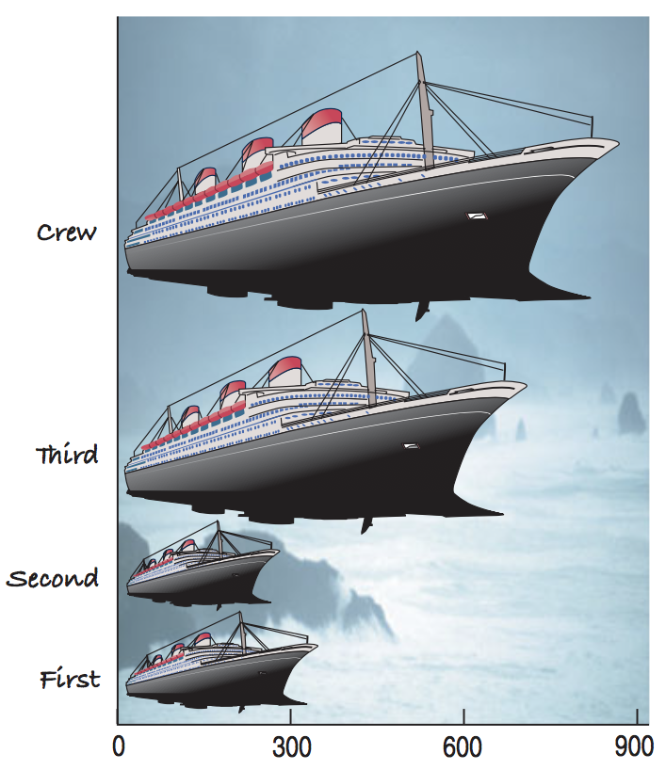
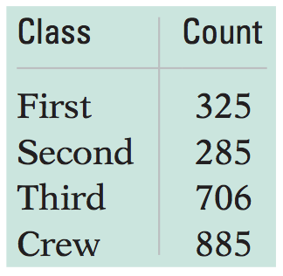
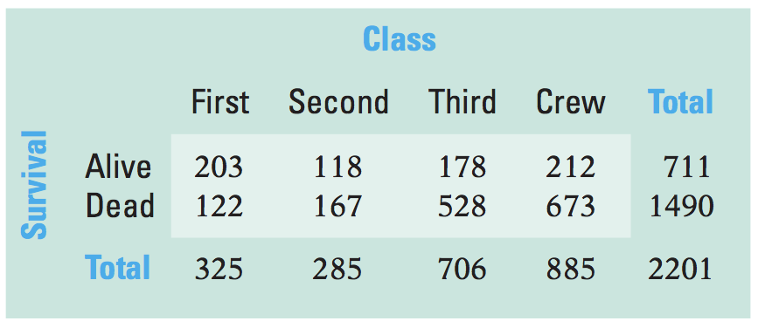
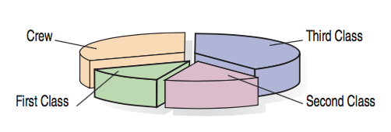
Lecture 03
Textbook’s example data
Frequency/contingency table of “ticket class” and “Survival” for the Titanic passengers
Frequency table
Contingency table
What’s wrong with this plot?
“Area principle”: the area occupied by a part of the graph should correspond to the magnitude of the value it represents.
CHOONG-WAN WOO | COCOAN lab | http://cocoanlab.github.io

Slide 9
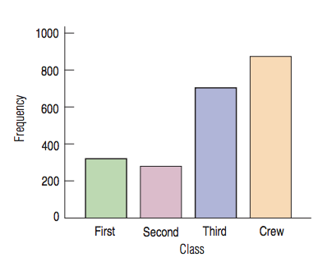
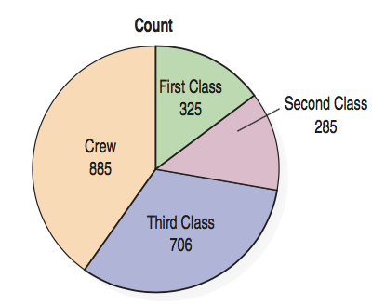
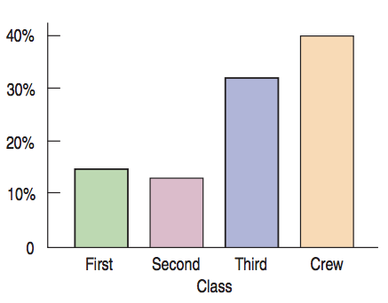
Lecture 03
Bar Charts, Pie Charts
Relative frequency bar chart
CHOONG-WAN WOO | COCOAN lab | http://cocoanlab.github.io

Slide 10
Lecture 03
Marginal distribution, conditional distribution
Marginal distribution of “Survival”
Contingency table
Conditional distribution
(satisfy a condition on another variable)
Marginal distribution of “Class”
CHOONG-WAN WOO | COCOAN lab | http://cocoanlab.github.io

Slide 11
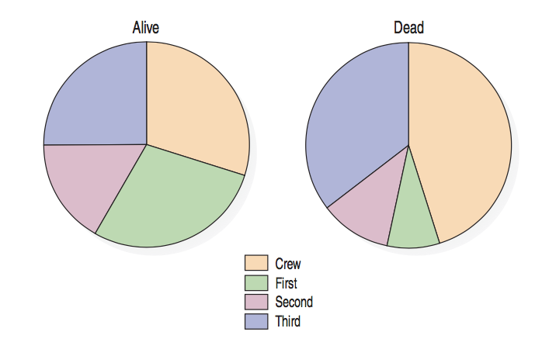
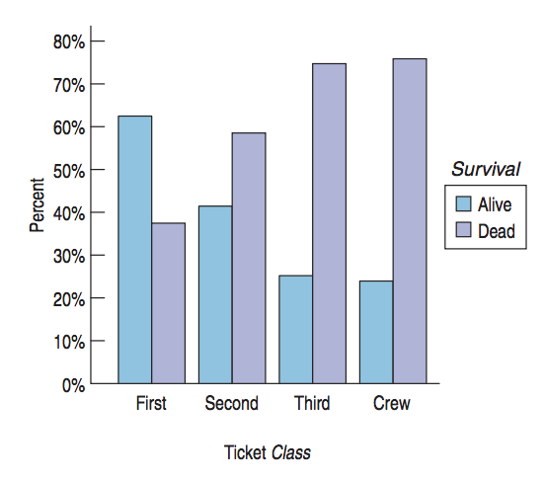
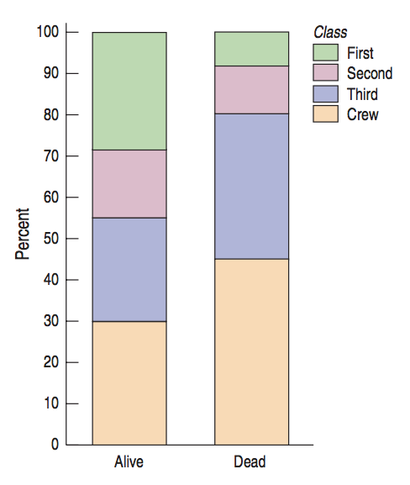
Lecture 03
Charts for conditional distribution
The variables are independent: “when the distribution of one variable tells us nothing about the distribution of the other variable”
CHOONG-WAN WOO | COCOAN lab | http://cocoanlab.github.io

Slide 12
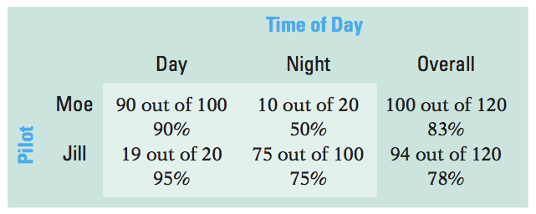
Lecture 03
Simpson’s Paradox
Two pilots, Moe and Jill
Who is the better pilot?
Proportion of on-time flights
CHOONG-WAN WOO | COCOAN lab | http://cocoanlab.github.io

Slide 13
Lecture 03
Simpson’s Paradox
Two pilots, Moe and Jill
Who is the better pilot?
Now who is the better pilot?
Don’t average over things unfairly
Different numbers in different categories for Day and Night
Unfair to average across categories
Proportion of on-time flights
CHOONG-WAN WOO | COCOAN lab | http://cocoanlab.github.io

Slide 14
Lecture 03
Quiz!
https://forms.gle/rAdXTtcgRoA7KjGJ6
CHOONG-WAN WOO | COCOAN lab | http://cocoanlab.github.io

Slide 15
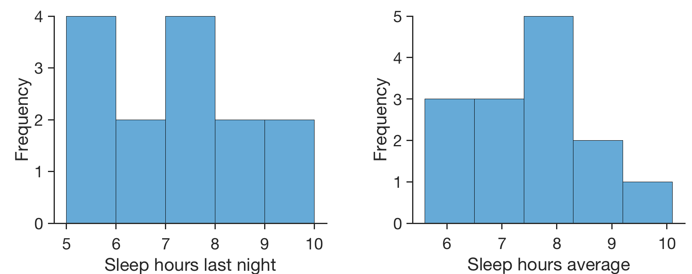
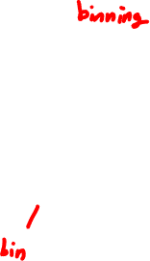
Lecture 03
Histograms for quantitative data
 | sleep_hours_last_night | sleep_hours_average
Indiv 1 | 7 | 6
Indiv 2 | 5.5 | 6.5
Indiv 3 | 9 | 7
Indiv 4 | 5 | 7
Indiv 5 | 5 | 6
Indiv 6 | 7 | 8
Indiv 7 | 8 | 7
Indiv 8 | 7 | 8
Indiv 9 | 8 | 10
Indiv 10 | 10 | 9
Indiv 11 | 6 | 7.5
Indiv 12 | 7 | 9
Indiv 13 | 6 | 8
Indiv 14 | 5 | 8
CHOONG-WAN WOO | COCOAN lab | http://cocoanlab.github.io

Slide 16
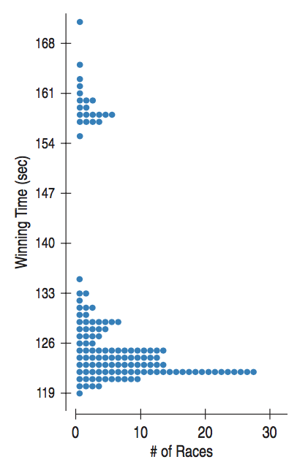
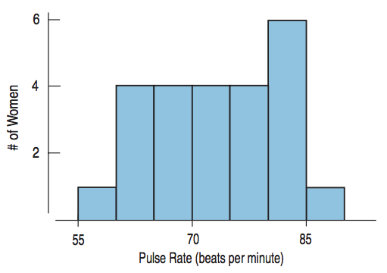
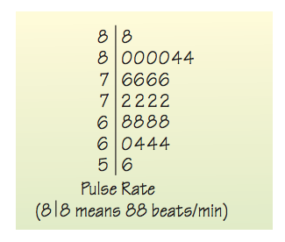
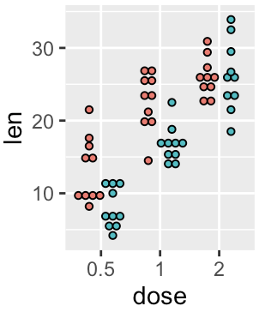
Lecture 03
Stem/leaf, dot plot
Histogram
Stem-and-leaf display
Dotplots
CHOONG-WAN WOO | COCOAN lab | http://cocoanlab.github.io

Slide 17
Lecture 03
Shape
Modes?
http://researchhubs.com/post/ai/data-analysis-and-statistical-inference/visualizing-numerical-data.html
CHOONG-WAN WOO | COCOAN lab | http://cocoanlab.github.io

Slide 18
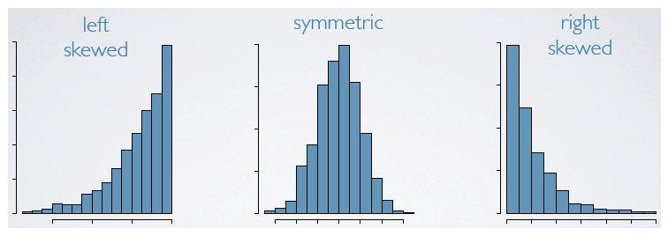
Lecture 03
Shape
Modes?
Symmetric?
http://researchhubs.com/post/ai/data-analysis-and-statistical-inference/visualizing-numerical-data.html
CHOONG-WAN WOO | COCOAN lab | http://cocoanlab.github.io

Slide 19
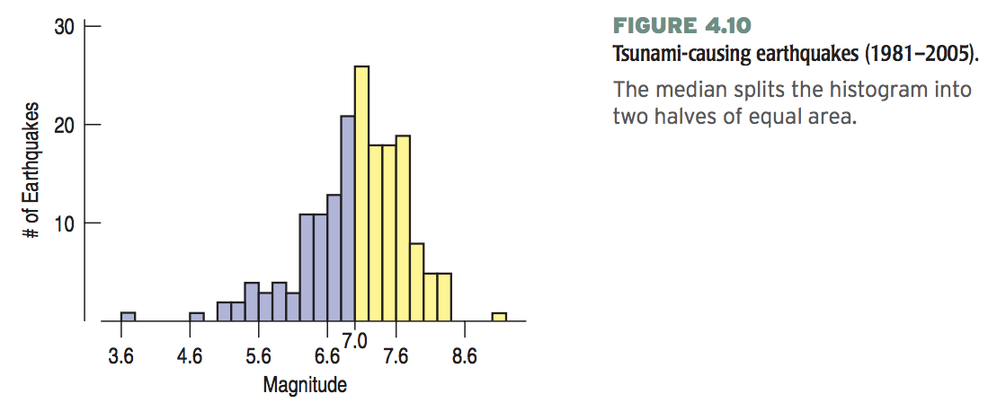
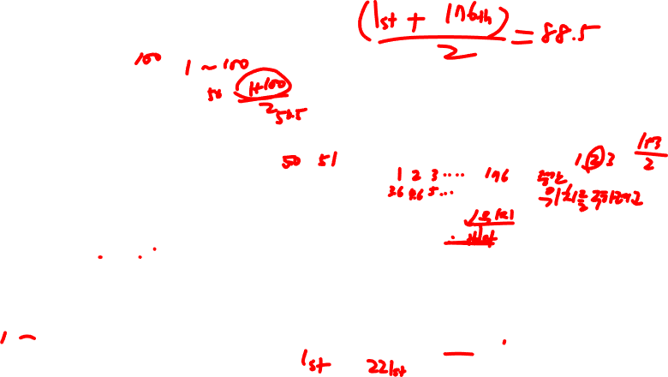
Lecture 03
Center
Median
176 earthquakes
Median: (176+1)/2 = 88.5th value in the sorted data
“.5” = average of the two values (88th and 89th)
If there was 221 earthquakes
Median: (221+1)/2 = 111th value in the sorted data
CHOONG-WAN WOO | COCOAN lab | http://cocoanlab.github.io

Slide 20
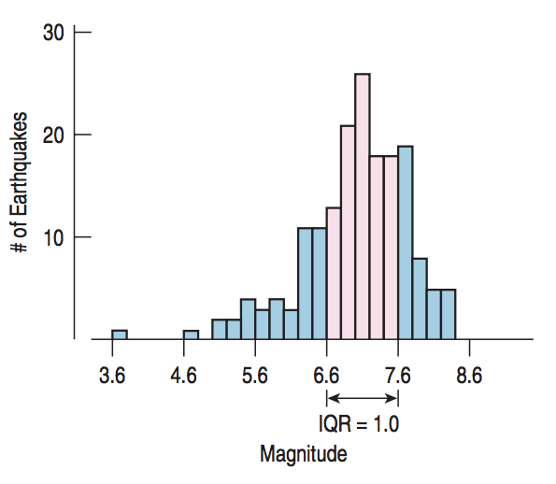
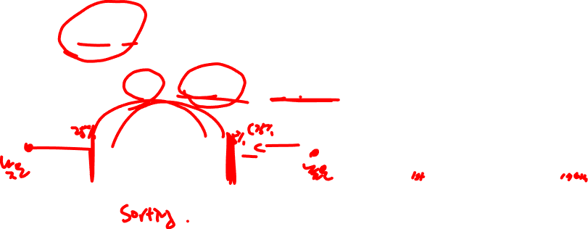
Lecture 03
Spread
Range
Range = max – min
Interquartile range
Interquartile range (IQR) = upper quartile – lower quartile
50%
CHOONG-WAN WOO | COCOAN lab | http://cocoanlab.github.io

Slide 21
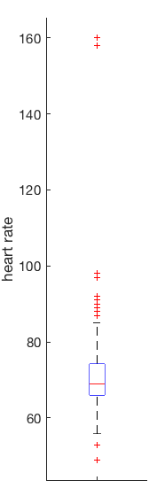
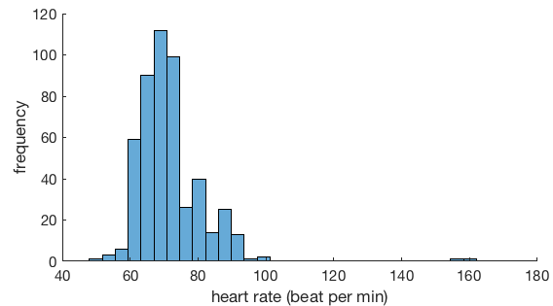
Lecture 03
Boxplots and 5-Number Summaries
far outliers
My heart rate data for a week (7/10-7/14)
Max | 160
Q3 | 74
Median | 69
Q1 | 66
Min | 49
outliers
Q3 + 1.5 IQR
Q3
Median
Q1
Q1 - 1.5 IQR
CHOONG-WAN WOO | COCOAN lab | http://cocoanlab.github.io

Slide 22
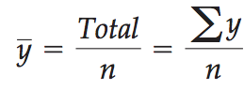
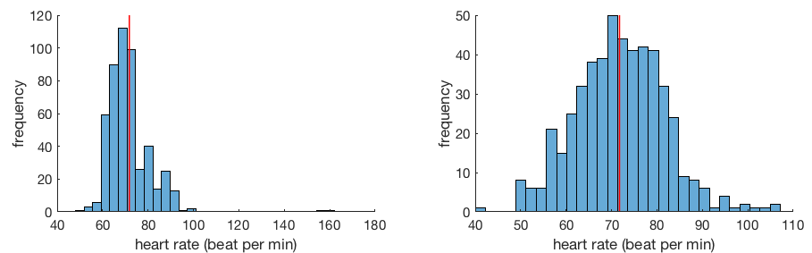
Lecture 03
Center of Symmetric Distribution: Mean
If the histogram is symmetric and there are no outliers, the mean will be preferable.
However, if the histogram is skewed or has outliers, the median might be better.
CHOONG-WAN WOO | COCOAN lab | http://cocoanlab.github.io

Slide 23
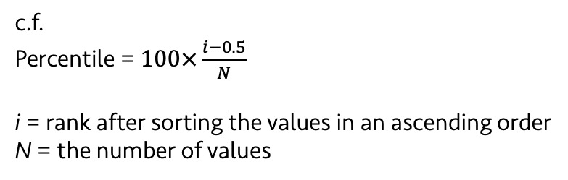
Lecture 03
Quiz!
https://forms.gle/jxEvNUTLTpZpfPnv9
c.f.
Percentile = $100×\frac{i−0.5}{N}$
i = rank after sorting the values in an ascending order
N = the number of values
CHOONG-WAN WOO | COCOAN lab | http://cocoanlab.github.io

Slide 24
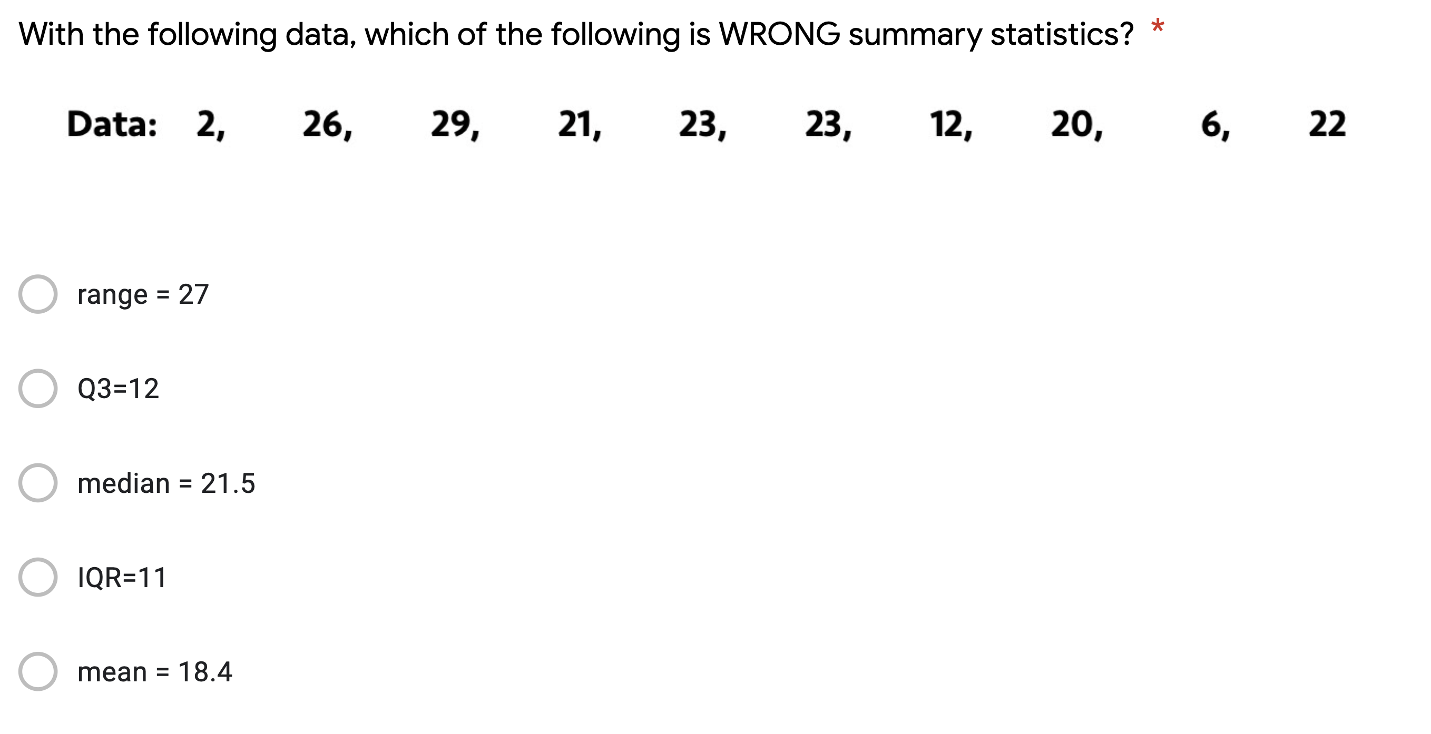
Lecture 03
Quiz!
https://forms.gle/QUF7YidhizhMpT7b7
c.f.
Percentile = $100×\frac{i−0.5}{N}$
i = rank after sorting the values in an ascending order
N = the number of values
CHOONG-WAN WOO | COCOAN lab | http://cocoanlab.github.io

Slide 25
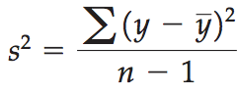
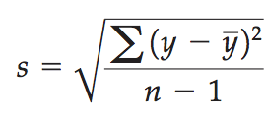
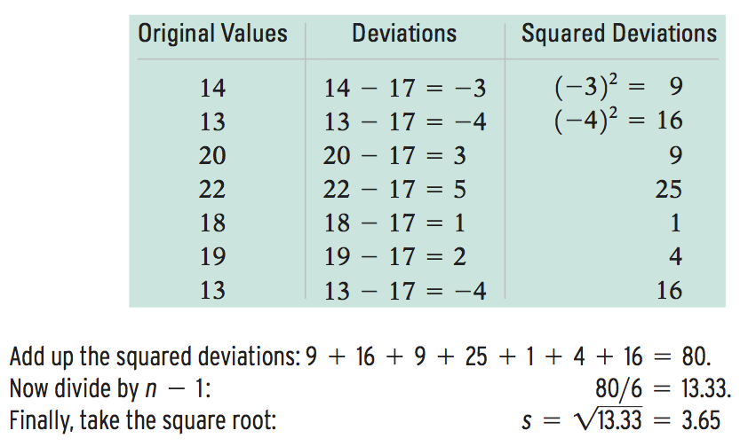
Lecture 03
Spread of Symmetric Distribution: Standard Deviation
Variance
Standard Deviation
Mean = 17
CHOONG-WAN WOO | COCOAN lab | http://cocoanlab.github.io

Slide 26
Lecture 03
Quiz!
https://forms.gle/7UnA2spepxwb4brw6
CHOONG-WAN WOO | COCOAN lab | http://cocoanlab.github.io

Slide 27
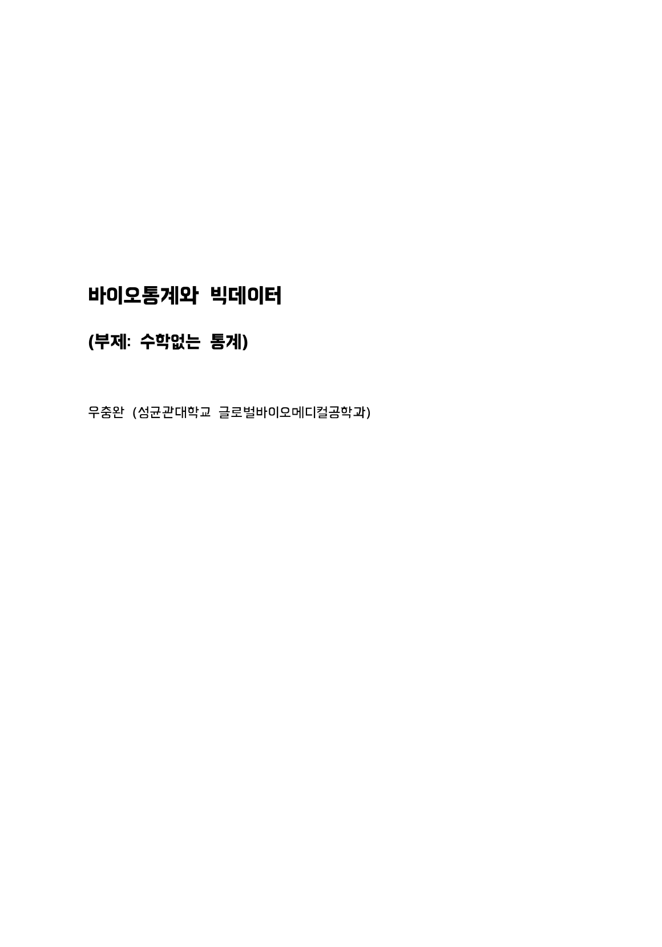
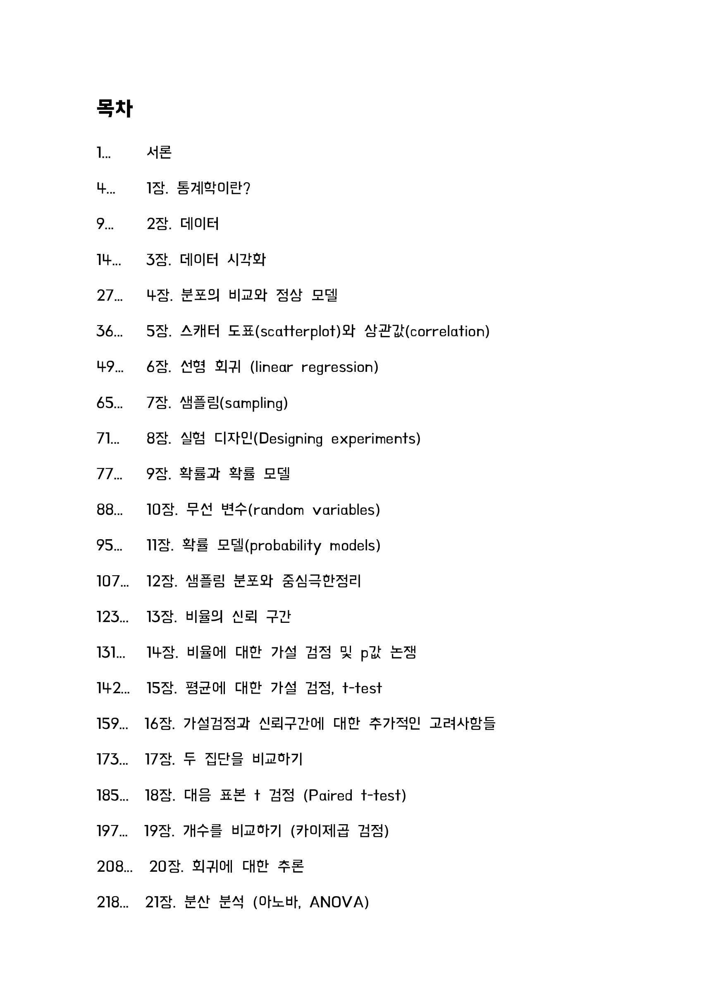
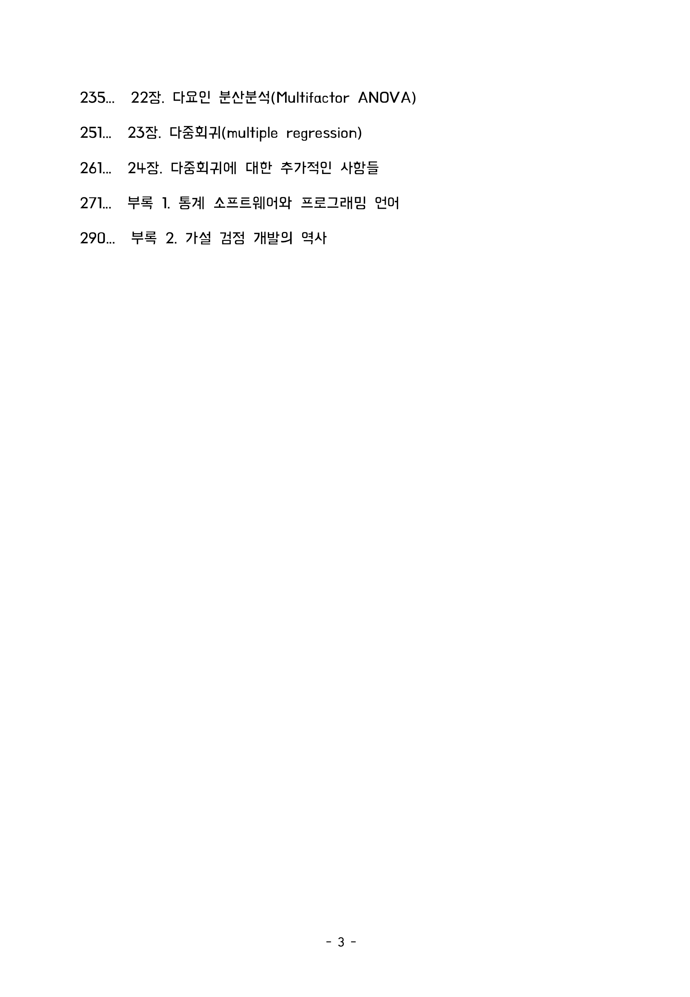
Lecture 03
Textbook for the class? (I will share it through slack)
CHOONG-WAN WOO | COCOAN lab | http://cocoanlab.github.io

Slide 28
Lecture 03
Key Points
Chapter 3: Displaying categorical data
Bar chart for categorical data
Pie chart for proportions of whole
Faithful reporting and the area principle
Contingency tables
Simpson’s paradox
Chapter 4: Displaying quantitative data
Histograms, Stem-leaf, dot plots
Shape (mode, symmetrical)
Center (median, mean)
Spread (range, IQR, variance, standard deviation)
Box plots
CHOONG-WAN WOO | COCOAN lab | http://cocoanlab.github.io

